Slide 1

MALIGNANT COMMENTS CLASSIFIER

Slide 2

Introduction of the Project
The proliferation of social media enables people to express their opinions widely online. However, at the same time, this has resulted in the emergence of conflict and hate, making online environments uninviting for users. Although researchers have found that hate is a problem across multiple platforms, there is a lack of models for online hate detection.
Our goal is to build a prototype of online hate and abuse comment classifier which can used to classify hate and offensive comments so that it can be controlled and restricted from spreading hatred and cyberbullying.

Slide 3
Problem Statement
Online hate, described as abusive language, aggression, cyberbullying, hatefulness, and many others has been identified as a major threat on online social media platforms. Social media platforms are the most prominent grounds for such toxic behavior.
There has been a remarkable increase in the cases of cyberbullying and trolls on various social media platforms. Many celebrities and influences are facing backlash from people and have to come across hateful and offensive comments. This can take a toll on anyone and affect them mentally leading to depression, mental illness, self-hatred, and suicidal thoughts.
Our goal is to build a prototype of online hate and abuse comment classifier which can be used to classify hate and offensive comments so that they can be controlled and restricted from spreading hatred and cyberbullying.

Slide 4
Data Processing
First we check the information of the given dataset because it tells how many rows and columns are present in our dataset and the data type of the columns whether they are object, integer, or float.
Dropping duplicates rows if present in the dataset.
Then we check for the null values present in our dataset. If null values are present then drop it because we cannot able to fill the text data.
To visualize the number of missing values in different-2 columns we use the Missingno library.
After that we check the summary statistics of our dataset. This part tells about the statistics of our dataset i.e. mean, median, max value, and min values, and also it tells whether outliers are present in our dataset or not.

Slide 5
Data Processing
We also check the correlation of our target features with each other. If columns are highly correlated with each other let’s say 90% or above then remove those columns to avoid the multicolinearity problem
Then we check our label that it is balanced or not. If it is unbalanced then we use a sampling technique to balance it.
We also create new columns to check the length of data before cleaning the Input feature column.
There are six features in this dataset so we combined them and make one target feature giving the name as a label and also we do scaling for that feature.

Slide 6
DATA CLEANING
In data cleaning we use mainly five steps using the function:
Removing HTML tags
Removing special characters
Converting everything to lowercase
Removing stopwords
Using WordNetLemmatization for lemmatization
We create a new column (clean_text) after removing punctuations, stopwords from the input feature to check how much data is cleaned.

Slide 7
VISUALIZATION
We plot the correlation matrix via heatmap to see the correlation of the columns with o er columns.
We plot countplot for target column to check that it is balanced or not .
Plotting the distribution of label i.e. Malignant or Benign before cleaning the label feature.
Plotting the distribution of label i.e. Malignant or Benign after cleaning the label feature.
Plotting the wordcloud for getting the sense of loud words for Malignant comments.
Also same wordcloud plot for getting the sense of loud words for Benign comments.
Similarly we can also make wordcloud for separate columns where you can check the loud words for particular features because there are six target features.

Slide 8
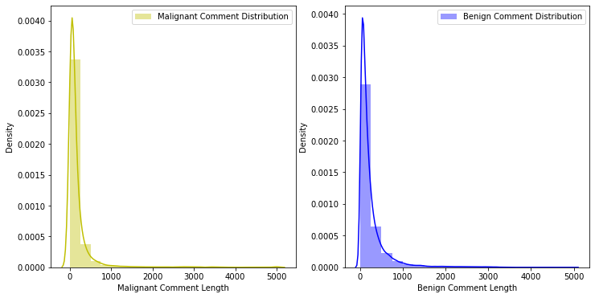
VISUALIZATION

Slide 9
MODELLING STEPS
Before making the model we convert our text into vectors so for that we use a technique known as TF-IDF Vectorizer
We know that this is a classification problem so we use the accuracy score, classification report, and confusion matrix as our evaluation matrix. We also see the AUC score and also plot the AUC_ROC curve for our final model.
As we know this dataset is imbalanced so we don’t too much focus on the accuracy score . We see the precision and recall value along with f1_score.
First, we see the result without doing any sampling technique and for that, I use Logistic Regression with KFold cross-validation and hyperparameter tuning.
We also use Random Forest and XGBoost as our evaluation model without using hyperparameter tuning because our dataset is too large and it takes more than an hour to give the result.

Slide 10
SAMPLING TECHNIQUES
Now we use Sampling technique to balance our dataset and then apply different-2 Classification models and see which model gives the best results and save that model as our final model.
Under Sampling: By using the under sampling we are trying to reduce the points of maximum labels.
Over Sampling: By using the over sampling we are trying to increase the points of minimum labels.
SMOTETomek: SMOTETomek is a hybrid method which uses on under sampling method (Tomek) in with over sampling method (SMOTE).

Slide 11
FINALIZING THE MODEL
Over Sampling models give the best result among all the sampling models so we keep this model as our final model.
We use XGBoost Classifier with over-sampled data and it gives the best Recall and AUC Score as well as fi_score.
Accuracy score is very good approx 95% and AUC score is 81.33%.
We also plot the AUC ROC curve and confusion matrix for this model.
We save this model as our final model as a pickle file with the help of Joblib.
Under sampling model gives poor result so basically use under sampling where dataset is small.

Slide 12
CONCLUSION
In this project the sample data is provided to us from our client database.
This project is more about exploration, feature engineering, and classification that can be done on this data. Since the data set is huge and includes many categories of comments, we can do a good amount of data exploration and derive some interesting features using the comments text column available.
We make a machine learning model in order to improve the need to build a model that can differentiate between comments and its categories.

